Slide 1
Plan-Driven vs. Agile
Maaret Pyhäjärvi

Slide 2
Outline
Plan-Driven vs. Agile in Development and Testing
Experiences in Exploratory Testing
Comparing Plan-Driven and Agile Testing Ideals

Slide 3
Plan-Driven vs. Agile in Development and Testing

Slide 4
Plan-Driven and Agility - Values Source: Agile Alliance website <http://www.agilealliance.com>
Plan-driven Values
Agile Values
Processes and tools
Individuals and interactions
Comprehensive documentation
Working software
Contract negotiation
Customer collaboration
Following a plan
Responding to change

Slide 5
Plan-Driven vs. Agile Methods
Plan-driven
Well-understood, repeatable processes
Plan as the center of the project
Plan is made to achieve goals (requirements)
Follow-up on:
Progress
Deviations from planned
Corrective actions brings one back to the planned state
Agile
Complex and unanticipated processes
Results as the center of the project
Changes can’t and shouldn’t be avoided.
Nature of software development includes continuous learning.
Learning changes the plan
Often compared heavy vs. light and formal vs. informal – these miss the main difference!
Notes:
well-understood and repeatable wouldn’t include people...

Slide 6
Plan-Driven vs. Agile - Rationale
A - Start
B – Planned Result
In an extreme environment, following a plan produced the product you intended, not the product you needed.
C – Desired Result

Slide 7
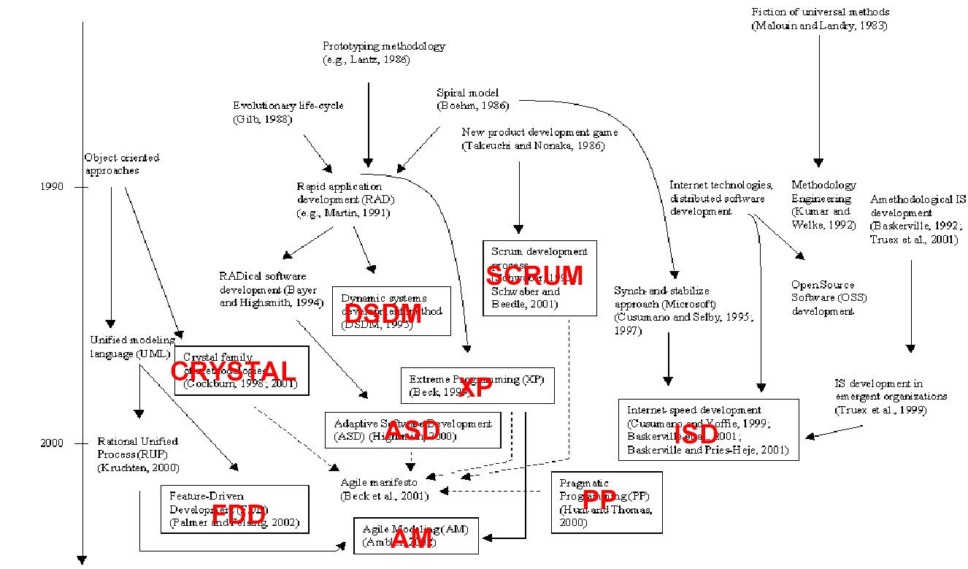
The World of Agile Methods
Source: Abrahamsson, P. et al. 2003. New Directions on Agile Methods: A Comparative Analysis. In ICSE 2003.
Notes:
Abrahamsson@ICSE 2003

Slide 8
Agile Testing
Two main breeds:
Exploratory Testing
Originates from testing community
Addresses ”system level testing”
Extreme Testing
Originates from development community (Extreme Programming)
Addresses ”unit level testing”
Requires higher-level tests (”acceptance tests”) but leaves out details of how these are included in process

Slide 9
Exploratory Testing vs. Ad Hoc Testing
Ad hoc testing: Test execution in which fault finding has not been prepared for: testing is not planned, its goals are not identified, there are are no expectations for results and randomness guides the activity.
Some people divide ad hoc testing in directed and undirected ad-hoc testing, in which directed ad hoc testing is used as a synonym for exploratory testing.

Slide 10
Mindset to Testing Impacts Test Planning and Control
Approaching the problem from two perspectives:
Identifying the differences in practices used in projects
Based on hands-on experiences
Comparing two exemplary cases - Ideals
Plan-driven testing approach as described in ISEB Foundation & Practitioner syllabi
Exploratory testing approach as described in articles and training materials by James Bach & Cem Kaner

Slide 11
Experiences in Exploratory Testing

Slide 12
Three Depths of Exploratory Testing
ET Session
- ET as a technique
ET Team
- ET as a group’s practice
ET Project
- ET as testing process
Notes:
Explain that while my the experiences I describe for myself go to the ET-project extreme, there has been successfull smaller scale application of the same things in smaller scope, within sessions – idea taken from session-based test management.

Slide 13
Experiences from ET Sessions
Exploratory Testing Sessions used during a one-year period
From once-a-week to twice-a-week
Session length 1,5 hrs (tried 1-3 hrs) and 10 people involved at a time
A planned approach
Not within the master test planning but short-term – a week at a time
Goal or theme for each session
Metrics gathered

Slide 14
Challenges in Getting Started
Proving the usefulness
Ability to find new issues planned tests would not find
Good use of resources – measured effort/bug and compared ET (Exploratory testing) and ST (Planned system testing)
Finding the right people
Characterictics guided the selection:
Naturally curious
Not too pattern-oriented but willing to think out-of-the-box
Willingness – not for everyone’s taste

Slide 15
What Happened in ET Sessions
In session
Briefing
Goal/Theme
Approach
Pair testing
Testing and taking notes
Outside session
Reporting found bugs
Planning for session contents
Challenges:
Coverage measurement
Tooling
Notes:
Examples of session goals: stress&boot, different 3rd party software, additional equiments, bugs from previous releases,
Session goals from user experience point-of-view.
Kalvo 15:
En tiedä tarvitseeko kalvossa mainita, mutta käytimme approachina paljon parityöskentelyä. Se toi sopivasti eroa tavalliseen systeemitestaukseen. Yritimme kaikin keinoin välttää yksinäistä puurtamista.

Slide 16
A Positive Experience - Reasons
Metrics showed the approach both effective and efficient
Ability to acceptance test 3rd party software that could not be planned in detail
Ability to assess how product stability (non-repro bugs) progresses
Ability try out more combinations of external equipment easier as the loaning was short-term
Positive impact on social relationships between testers in different projects
Skills and tricks of the trade exchanged
Test data and ideas from other testers
Notes:
Kalvo 16:
Ehkä voisi vielä korostaa, että ET sessiossa voidaan hyvin seurata puhelimen stabiilisuuden kehittymistä. Eli tarkoitan niitä bugeja, jotka tapahtuvat joskus, mutta eivät systemaattisesti (reset, jamming jne.).
Esimerkiksi jotenkin
- Ability to follow general sw maturity and its progress

Slide 17
Experiences from an ET Project
Experiences from one exploratory testing project
Setting up expectations for test levels and pacing
Test strategy
Tasks, resources and schedules
Communication with development
Reporting and metrics

Slide 18
Test Levels, Phases and Types
Acceptance testing
System testing
Integration testing
regression
Unit testing
regression
Notes:
laatikot – vaiheita
vaaleat laatikot – jaettuja vaiheita
pallo – testauksen suunnitteluvaihe
tähti – esim. suorituskykytestaus integrointitestauksessa ja varmistukset osana vielä hyväksymistestauksen suoritusta
Korosta että taso yleensä eniten kuitenkin viittaa vastuun kohdistamiseen tiettyyn ryhmään ihmisiä – tapa allokoida resursseja tavoitteisiin ryhmitellen.

Slide 19
In-Synch vs. Off-Synch Testing
Length of preparation needed sets the pace of activities
In-synch testing comprises the testing tasks that can be done in the same pace as the development proceeds, in continuous fashion
Off-synch testing refers to the typical view of planned and prepared testing that takes too much time to be integrated into the daily/weekly pace of the development
Addressing the pace
brings structure to agility reminding different timescales of getting things done in testing
brings flexibility to plan-driven addressing tasks that shouldn’t be planned separately
Notes:
daily/weekly view – task-based. Developers aren’t creating modules, but functionality which may be spread into several modules.

Slide 20
Test Strategy
Plan-Driven
High-level goals set and documented before details
Address changes and customizations to strategy in the test plan
Separation of product/service view and project/maintenance view
Early test design
Agile
High-level goals set and communicated before details
Strategy changes to accommodate the needs
Not planning ahead requires keeping the product view in mind all the time
On-time test design
Notes:
Explain test case architecture as the control mechanism – dashboard and hour reporting structures

Slide 21
Tasks, Resources, Schedules
Plan-Driven
Detail in tasks and their estimates
Added detail in more specific plans, exceptions to plan noted
Tends to have more variance in the expected skill set
Separation (independence) makes most tasks off-synch
Agile
Fixed number of resources
Test case architecture as a general plan and reporting structure
Connect to dashboard, qualitative assessment
Collaboration capability essential
Structure to difference for in-synch/off-synch
Notes:
test manager vs. tester skills essential
Explain

Slide 22
Communication with Development
Plan-Driven
Independent testing
Focus on planned features, checking realization on a test release document
Requirements specifications
Agile
Collaborative testing
Focus on what is under construction, tips and hints on a test release document
Implementation tasks for the near future
Notes:
if it requires effort to build, it requires effort to test. If it requires little effort to change, it requires a lot of effort to test.

Slide 23
Reporting and Metrics
Plan-Driven
Test case – based
Aiming for quantification
Requirement traceability
Planned vs. realized effort
Agile
Test case architecture –based
Qualitative assessment on dashboard
Use of hours as in-project feedback mechanisms for quality of testing
Improvement of testing skills and focus of strategy
Bugs in an essential role in both
Notes:
Asking questions – what do we actually know now and should we continue the selected path?

Slide 24
Comparing Plan-Driven and Agile Testing Ideals

Slide 25
Plan-Driven vs. Agile in Testing (1/6) Source: Pyhäjärvi, M. & Rautiainen, K. 2004. Integrating Testing and Implementation into Development. Engineering Management Journal, June ‘04
Aspect | Plan-driven testing | Exploratory testing
Order of test execution | Low-level tests are executed before high-level tests. | Testing should take place on all levels in an order that makes most sense.
Role of test documentation | If documentation does not exist, testing is not done – aim at comprehensive unambiguous documentation. | Testing is documented to the extent needed weighing together costs and benefits.
What constitutes start of testing | Starting test planning with late execution is testing. | Test planning is not start of testing, if execution can’t be combined in an exploratory fashion.

Slide 26
Plan-Driven vs. Agile in Testing (2/6) Source: Pyhäjärvi, M. & Rautiainen, K. 2004. Integrating Testing and Implementation into Development. Engineering Management Journal, June ‘04
Aspect | Plan-driven testing | Exploratory testing
Focus in controlling the testing | V-model and size of testable items on each level. | Depth of testing for the system currently at hand based on its maturity.
View of test strategy | Seen as something above test project plans, combining several projects. | Seen as the projects tangible testing approach combining test techniques to quality criteria, project environment and product elements.
Test design | Early test design emphasized. | On-time test design emphasized.

Slide 27
Plan-Driven vs. Agile in Testing (3/6) Source: Pyhäjärvi, M. & Rautiainen, K. 2004. Integrating Testing and Implementation into Development. Engineering Management Journal, June ‘04
Aspect | Plan-driven testing | Exploratory testing
Test cases | Test case can be executed and interpreted by someone other than who designed it. The test case must define the expected output. | Questions to the software that may also be open-ended, even though thinking of the hypothesis is important, documentation need varies.
Test techniques | Preferably mathematical form, enables same results for different users. | Preferably heuristic form, enables useful results for different users.
Level of test-first design | Test design first by tester to find faults in high-level requirements. | Test first design by developer.

Slide 28
Plan-Driven vs. Agile in Testing (4/6) Source: Pyhäjärvi, M. & Rautiainen, K. 2004. Integrating Testing and Implementation into Development. Engineering Management Journal, June ‘04
Aspect | Plan-driven testing | Exploratory testing
Culture | Control, in form of emphasizing entry and exit criteria in testing. | Collaboration, in form of emphasizing testing as service providing value constantly.
Types of processes | Step-by-step processes, requiring as little interpretation as possible. | Backward-forward processes, leaving room for deciding when each process phase should be done.
Role emphasis | Emphasizes test manager and his skills. | Emphasizes each tester and his skills.

Slide 29
Plan-Driven vs. Agile in Testing (5/6) Source: Pyhäjärvi, M. & Rautiainen, K. 2004. Integrating Testing and Implementation into Development. Engineering Management Journal, June ‘04
Aspect | Plan-driven testing | Exploratory testing
Focus of improvement | Focus on developing methods. | Focus on developing skills.
View on practices | Best practices exist and should be applied. | All so-called best practices are just heuristics, rules of thumb.
Pacing testing | Testing to be planned is described as off-synch testing, responding to development in larger increments. | Testing to be planned is mixed off-synch and in-synch, with emphasis on in-synch testing and usually intuition-based describing the off-synch activities.

Slide 30
Plan-Driven vs. Agile in Testing (6/6) Source: Pyhäjärvi, M. & Rautiainen, K. 2004. Integrating Testing and Implementation into Development. Engineering Management Journal, June ‘04
Aspect | Plan-driven testing | Exploratory testing
Requirements specification | If you don’t have a specification, you can’t test. Thus you should require unambiguous requirements. | Requirements are useful fiction at best. Documentation is always only fiction – if it’s useful, excellent.
Validation and testing | Testing is verification and validation is done if needed. | Validation is an essential part of testing.

Slide 31
Combining Two of a Kind
Plan-driven
Agile
Project 1
Project 2
Testing group
Development group
+
+
Development group
Testing group
Notes:
I think that it might be possible, that an agile-minded testing group works fine with a plan driven development effort, as it follows the development in an agile fashion, whereas plan-driven testing group can’t accommondate the change needed for development to be agile and testing useful.

Slide 32
Mix and Match?
Plan-driven
Agile
Project 1
Testing group
Development group
Project 2
Development group
?
Testing group
Notes:
I think that it might be possible, that an agile-minded testing group works fine with a plan driven development effort, as it follows the development in an agile fashion, whereas plan-driven testing group can’t accommondate the change needed for development to be agile and testing useful.
Juha’s extermnal – not try to connect to same rythm

Slide 33
One Approach to Several Projects Is Sub-Optimal for All Source: Boehm, B., and R. Turner. 2003. Using Risk to Balance Agile and Plan-driven Methods. IEEE Computer 36, no. 6.
Mapping to analyze need of plan-driven vs. agile approach.
→ Seemingly similar are actually very different

Slide 34
Conclusions
Plan-driven and agile methods – including testing – have different home grounds
Different mindset has its impact on test planning
Development and testing pieces in the puzzle should fit together
Getting into the agile mindset has proved a challenge in practice

